Slide 1
FINAL PROJECT: SPOTIFY API
Participants:
Gracia Estrán Buyo
Beltrán Valero Castellano
Annunziata Álvarez-Cascos Hervías
Marta Almagro Fuello

Slide 2


PROJECT IDEA & GOAL
This project aims to provide the user with a unique experience by categorizing their playlists, tracks, and favorite artists' evolution. Additionally, it aims to offer playlist recommendations based on the user's preferences and the latest top music trends.

Slide 3
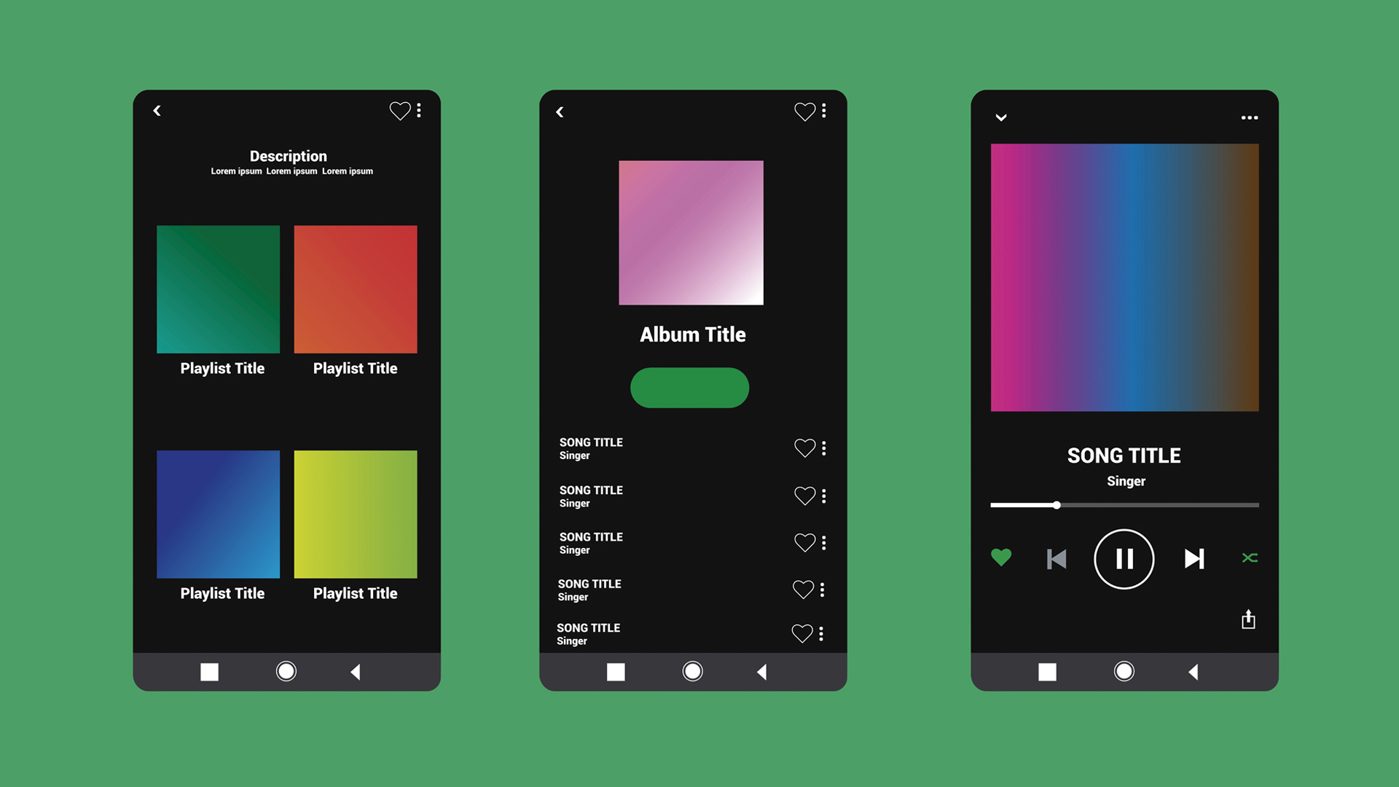
STATE OF THE ART

Slide 4





SPOTIFY API CAPACITIES
User Data
Audio Features
Access to
Music Catalog
Album and Artist Information
Authentication

Slide 5
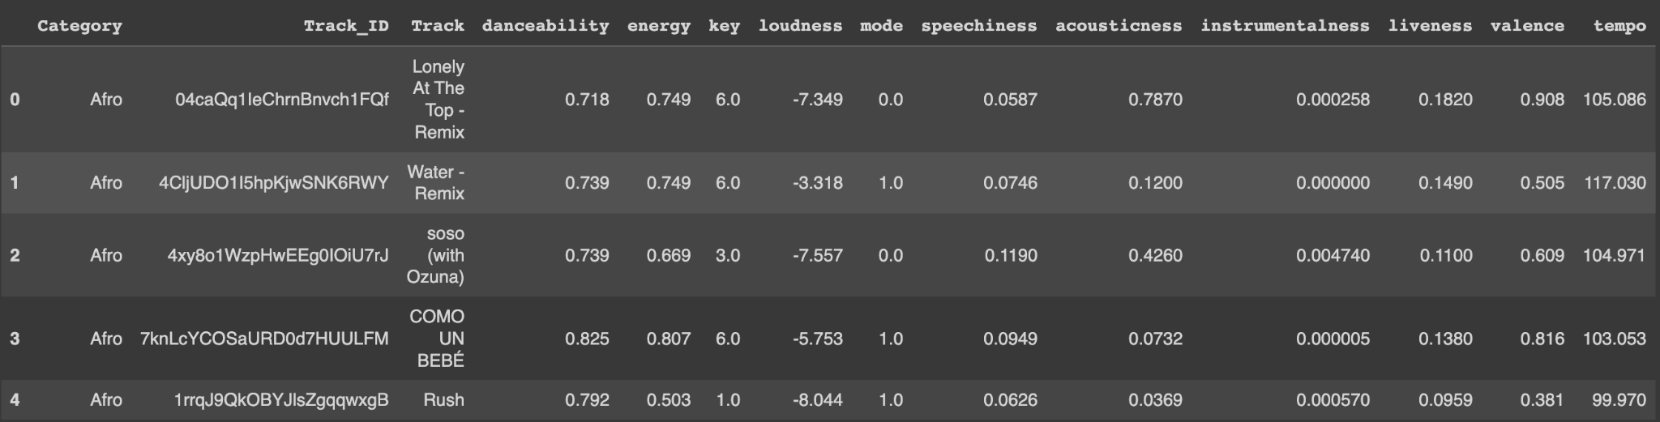
DETAILED DESCRIPTION OF THE FINAL USED DATA SOURCE

Slide 6

DETAILED DESCRIPTION OF THE FINAL USED DATA SOURCE
Retrieval of categories
Obtaining the tracks
Description of dataset
Cleaning 2
We firstly, retrieved all the categories from each country.
After we retrieved each song from the playlists (keeping in mind the category it belongs to)
The columns we have in our dataset are category, track_id, track, and its different audio features
We performed an analysis to delete all the outliers possible from each category.
2
4
6
8
1
3
5
7
Getting the playlists
Audio features
Cleaning 1
Machine learning
Then from each category we got the playlists from it (iterating through limit and offset).
For each song we retrieved its features by using a methods given by the API.
We deleted all the observations which had NaN values and the duplicated observations.
With the final dataset we trained different machine learning models to predict the category given the different audio features of the songs.
Notes:
The data source was built from different API requests.
1. We firstly, retrieved all the categories from each country.
2. Then from each category we got the playlists from it (iterating through limit and offset).
3. After we retrieved each song from the playlists (keeping in mind the category it belongs to)
4. For each song we retrieved its features by using a methods given by the API
5. Columns in the datset: category, track_id, track, audio_features
6. We deleted observations with nan, duplicated obs, and observations which were outliers in each of the categories to make our range smaller so that the predictions were more acurate
7. With his data we trained different models to preduct the category given the different audiofeautures
8. We saw

Slide 7

DETAILED DESCRIPTION OF THE DATA GATHERING TECHNIQUE
Our main source of data:

Slide 8
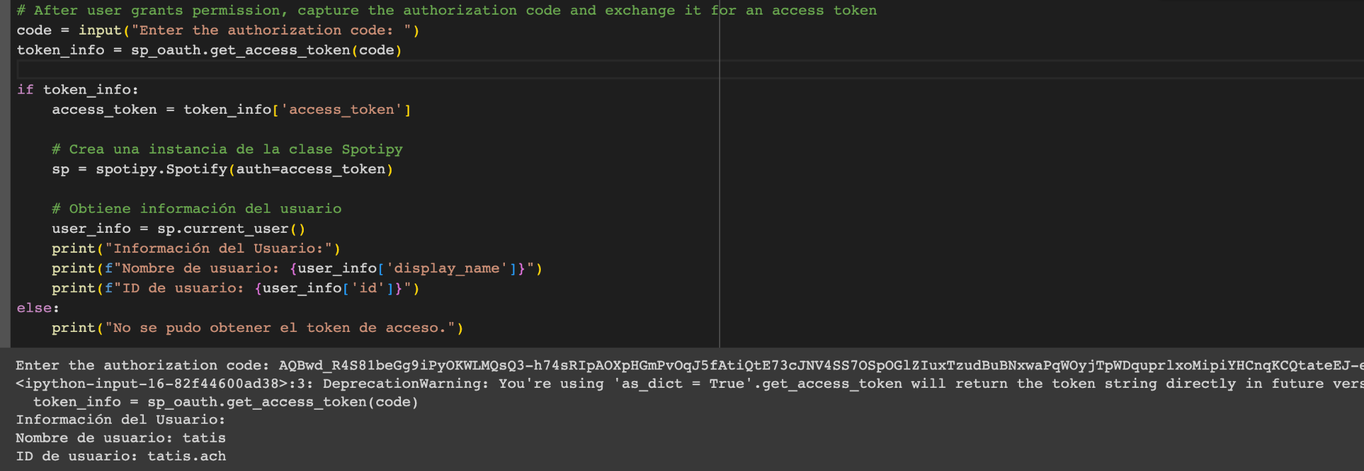
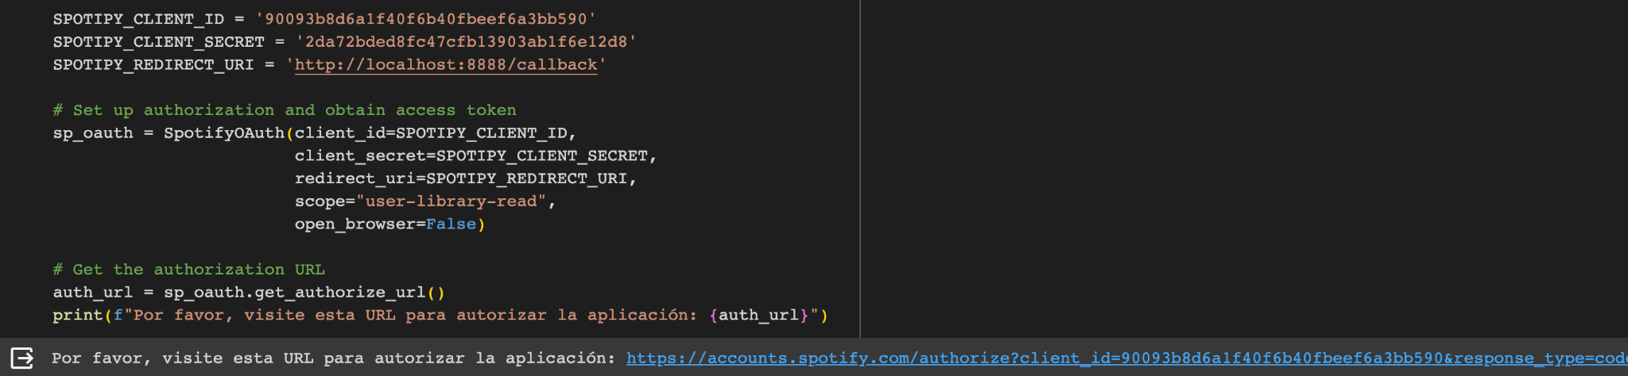
DETAILED DESCRIPTION OF THE DATA GATHERING TECHNIQUE
Authentication:
Set up authorization and obtain access token
Capture the authorization code and exchange it for an access token
Obtain User information
Declare Client ID Information
Get the authorization URL
Create an instance of the Spotipy class

Slide 9
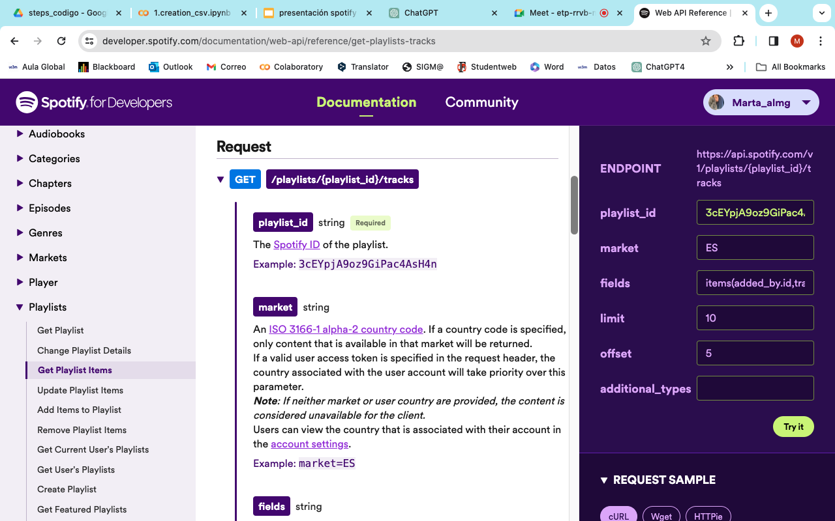
DETAILED DESCRIPTION OF THE DATA GATHERING TECHNIQUE
Some of the used functions provided by the API:

Slide 10
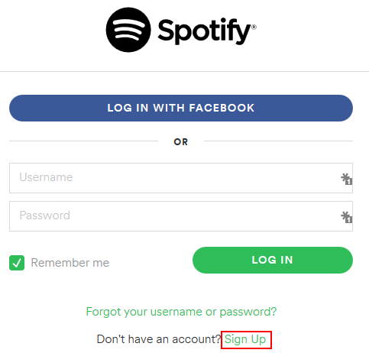
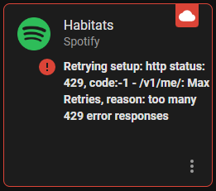

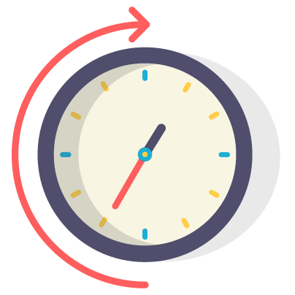
PROBLEMS AND MAIN CHALLENGES FACED IN THE PROCESS
Error: Max retries reached, too many 429 error responses
Created many accounts in order to be faster
Dataset creation took very long
Returns from spotify functions were very long dictionaries which made it harder to analyze.

Slide 11
USED ANALYSIS TECHNIQUES – SEARCH FOR THE BEST MODEL
Decision Trees
RandomForest
KNN
Logistic Regression
Support Vector Machines
TUNE THE HYPERPARAMETERS ->
Using GridSearchCV.

Slide 12
PREDICT WITH OUR MODEL
Why all this trouble to have an accurate model??
PREDICT THE CATEGORY OF THE PLAYLISTS AND SONGS OF OUR USERS

Slide 13
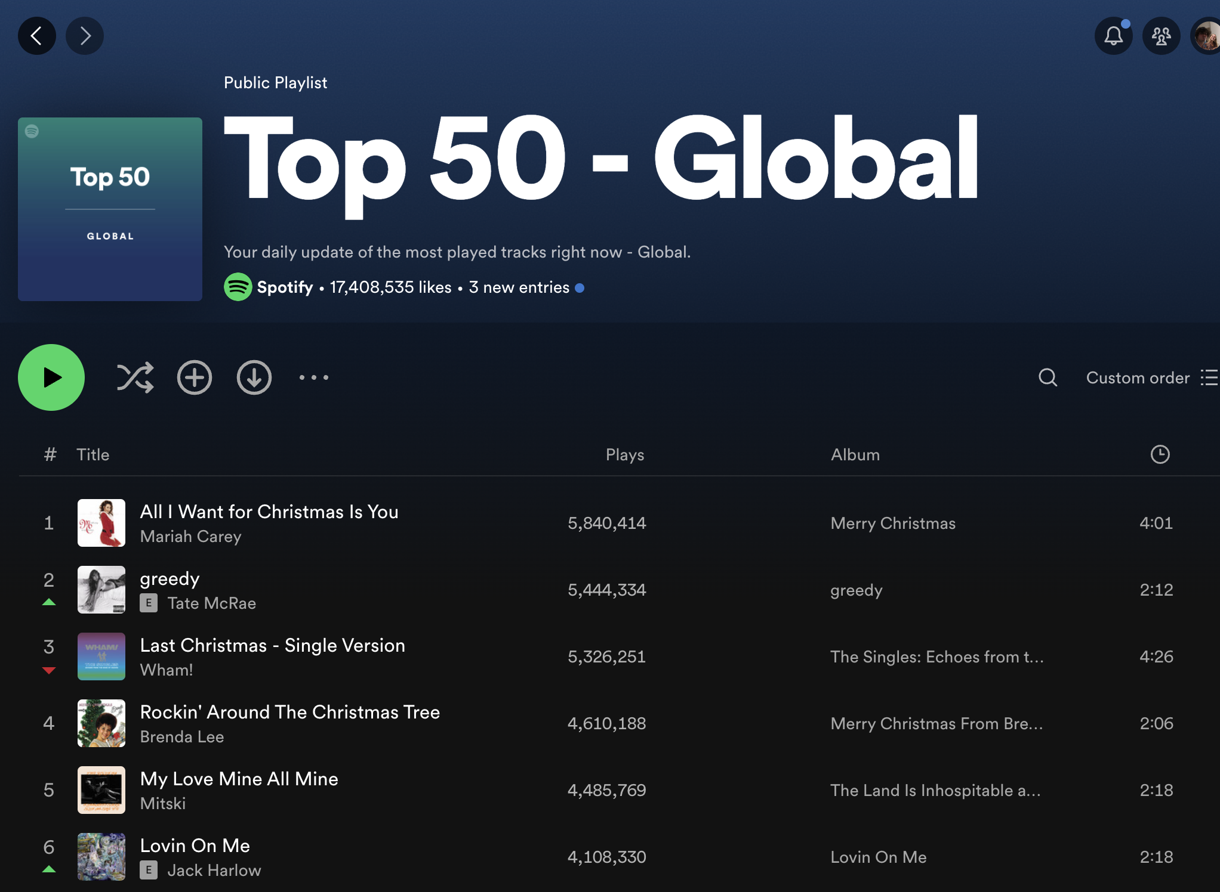
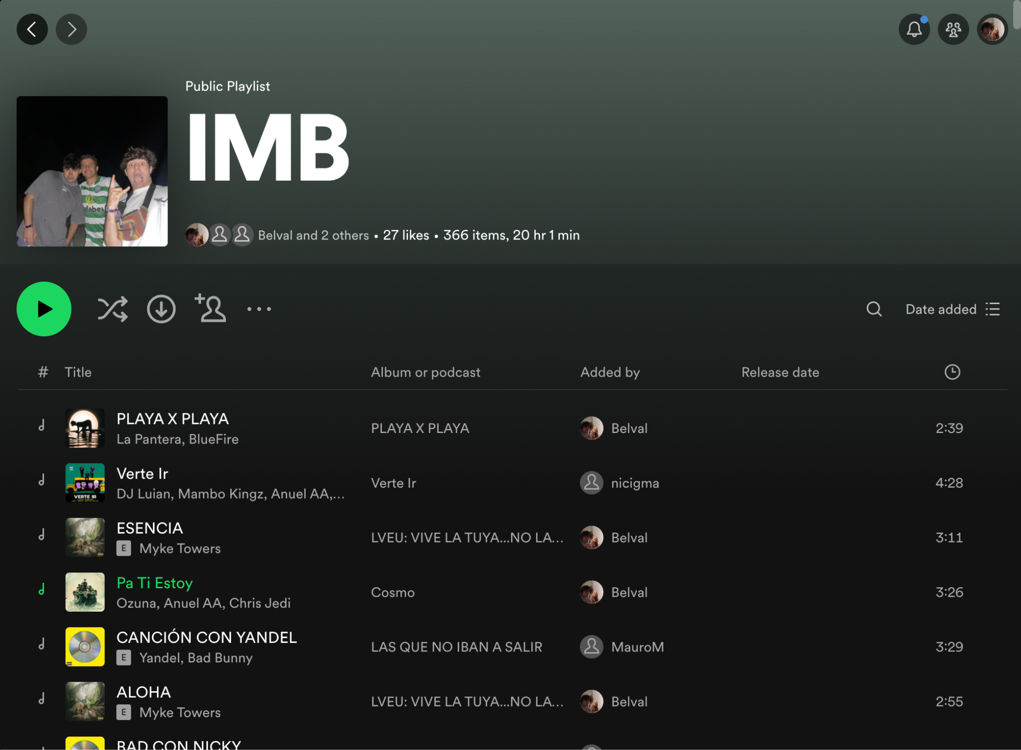
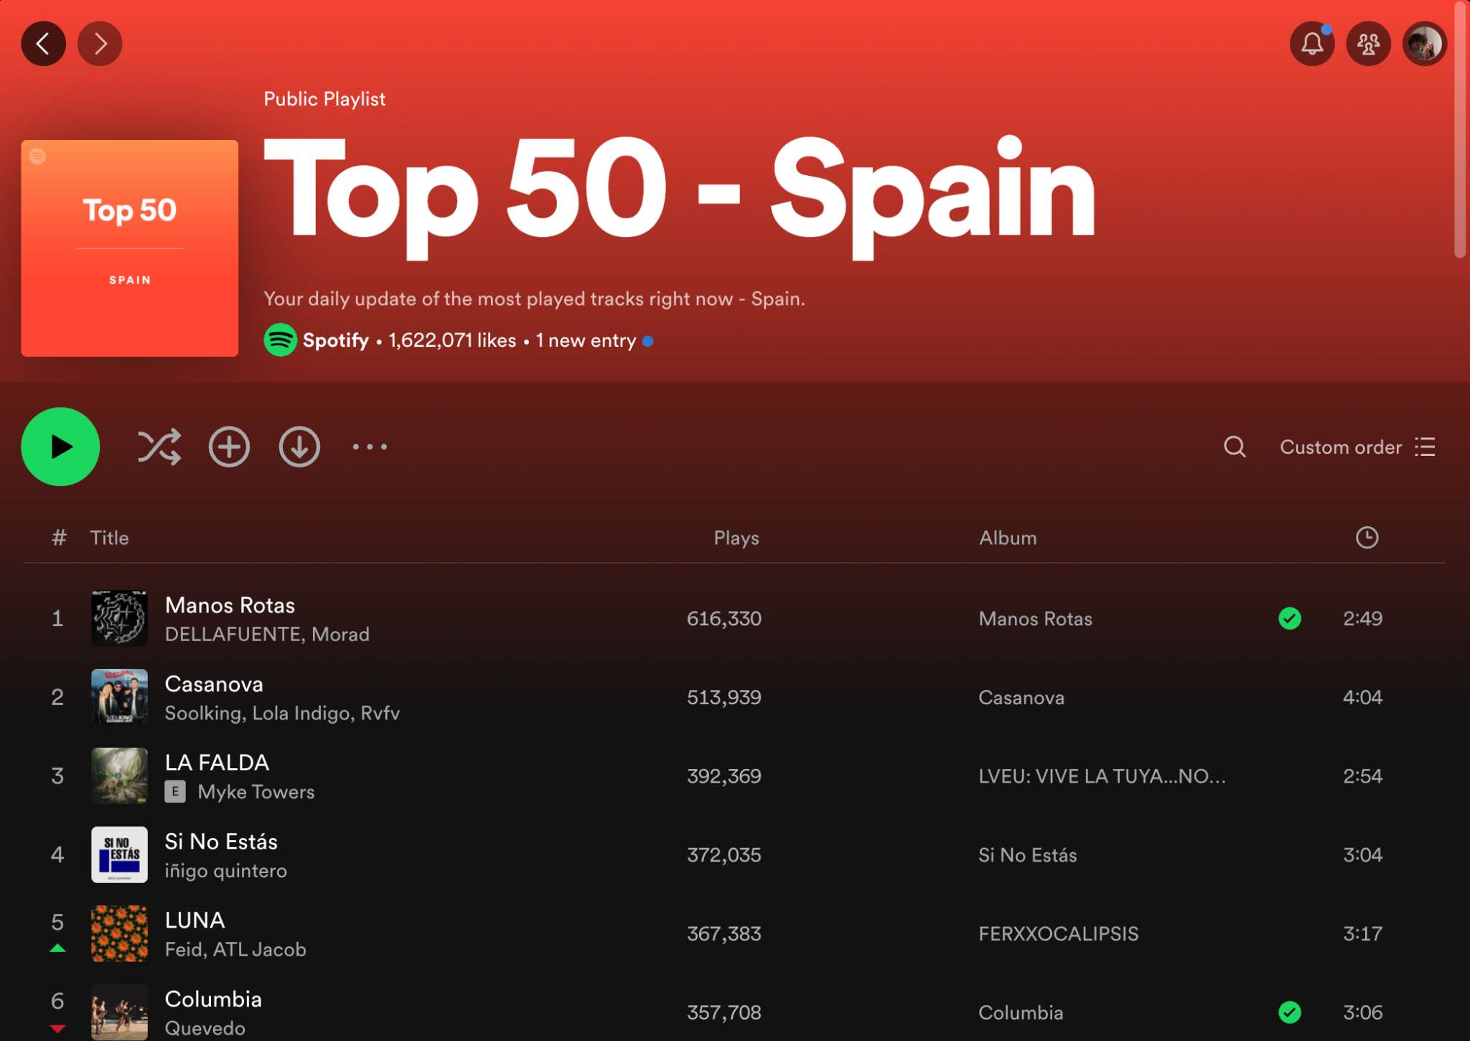
USED ANALYSIS TECHNIQUES – RECOMMENDER ALGORITHM

Slide 14
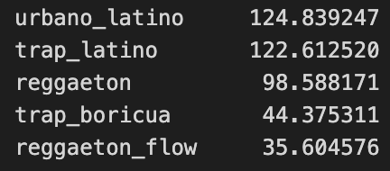
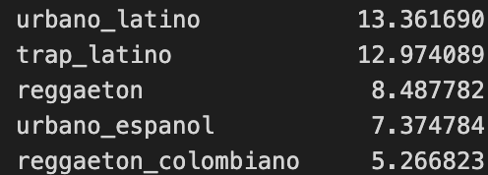
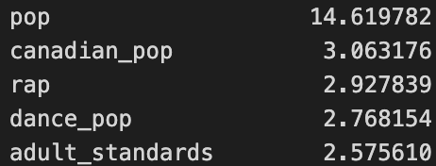
RECOMMENDER ALGORITHM-TOP GENRES
IMB
top Spain
Very similar
More difference
top Global

Slide 15
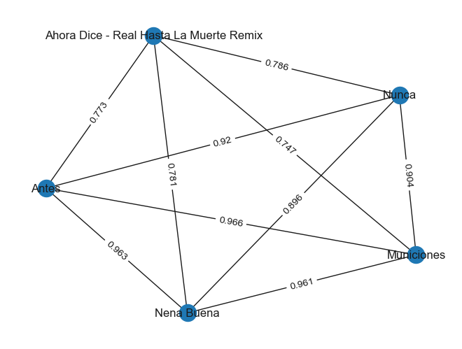
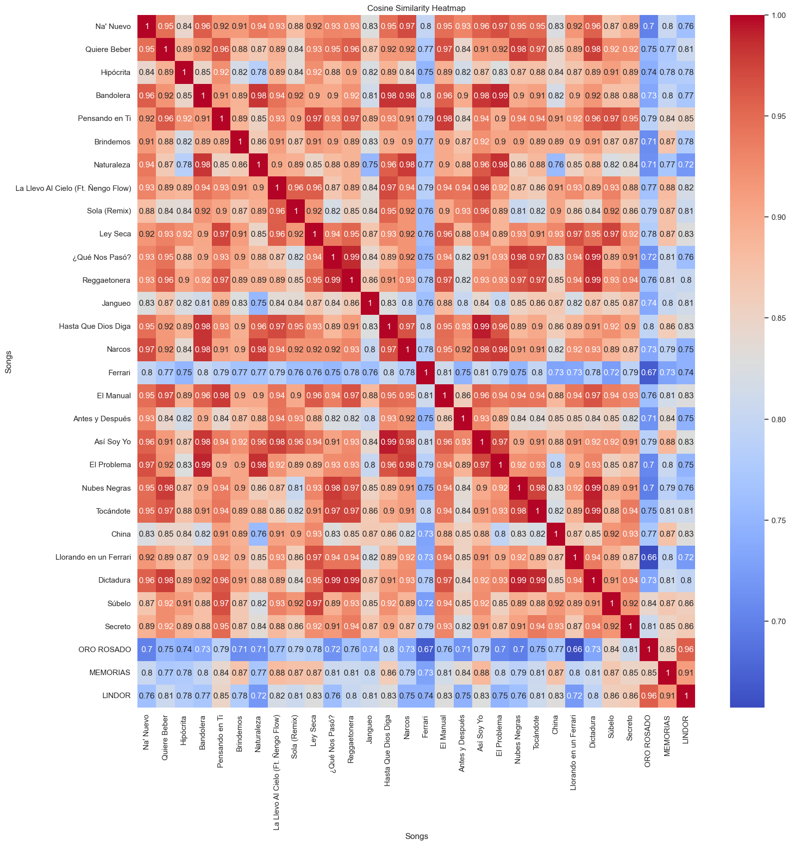
RECOMMENDER ALGORITHM-VISUALIZATION OF OUR PLAYLIST’S SIMILARITY
HEATMAP
GRAPH

Slide 16
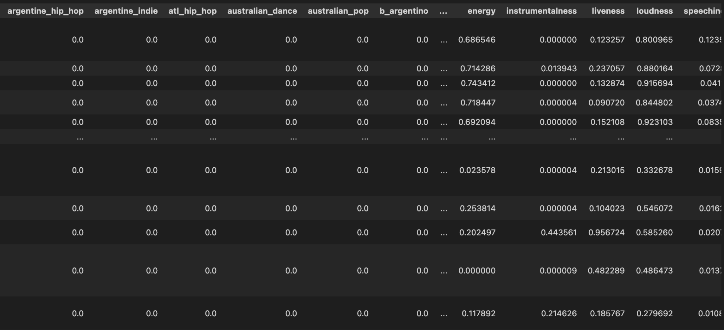
RECOMMENDER ALGORITHM - APPROACH
TF-IDF emphasis (i.e weights metadata terms based on how often they appear across our entire catalog)
TF - IDF for genres
Scale audio features
Create a single vector for our playlist
Make recommendation in base of cosine similarity of two vectors
1 and 2

Slide 17
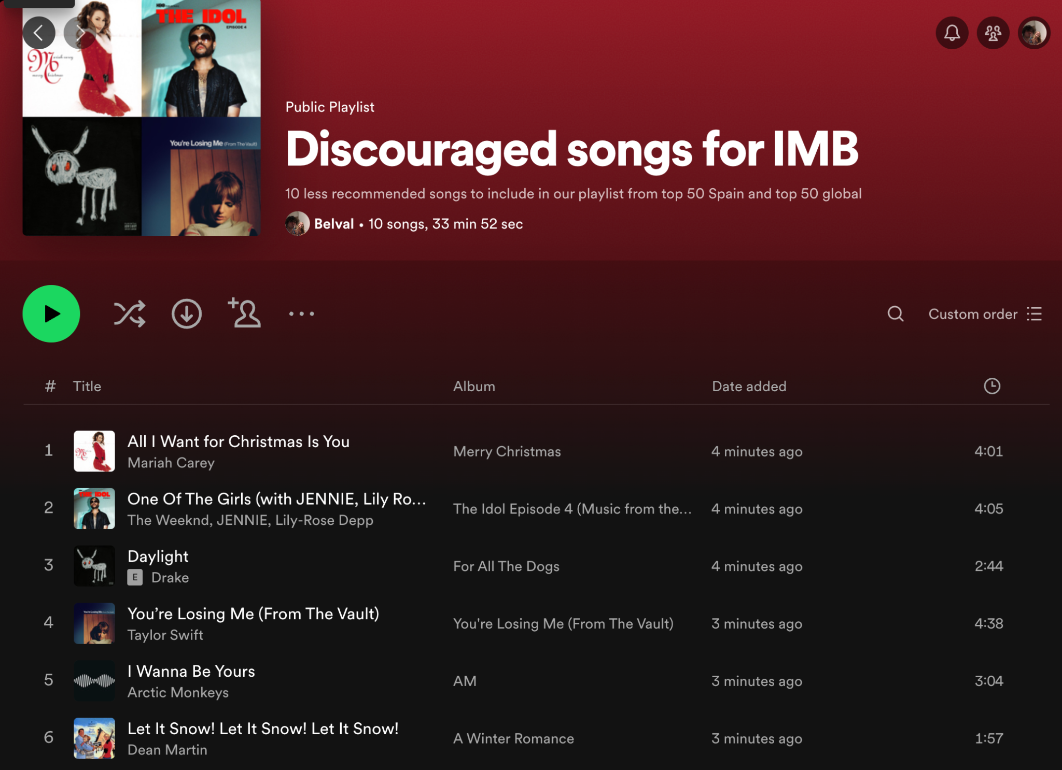
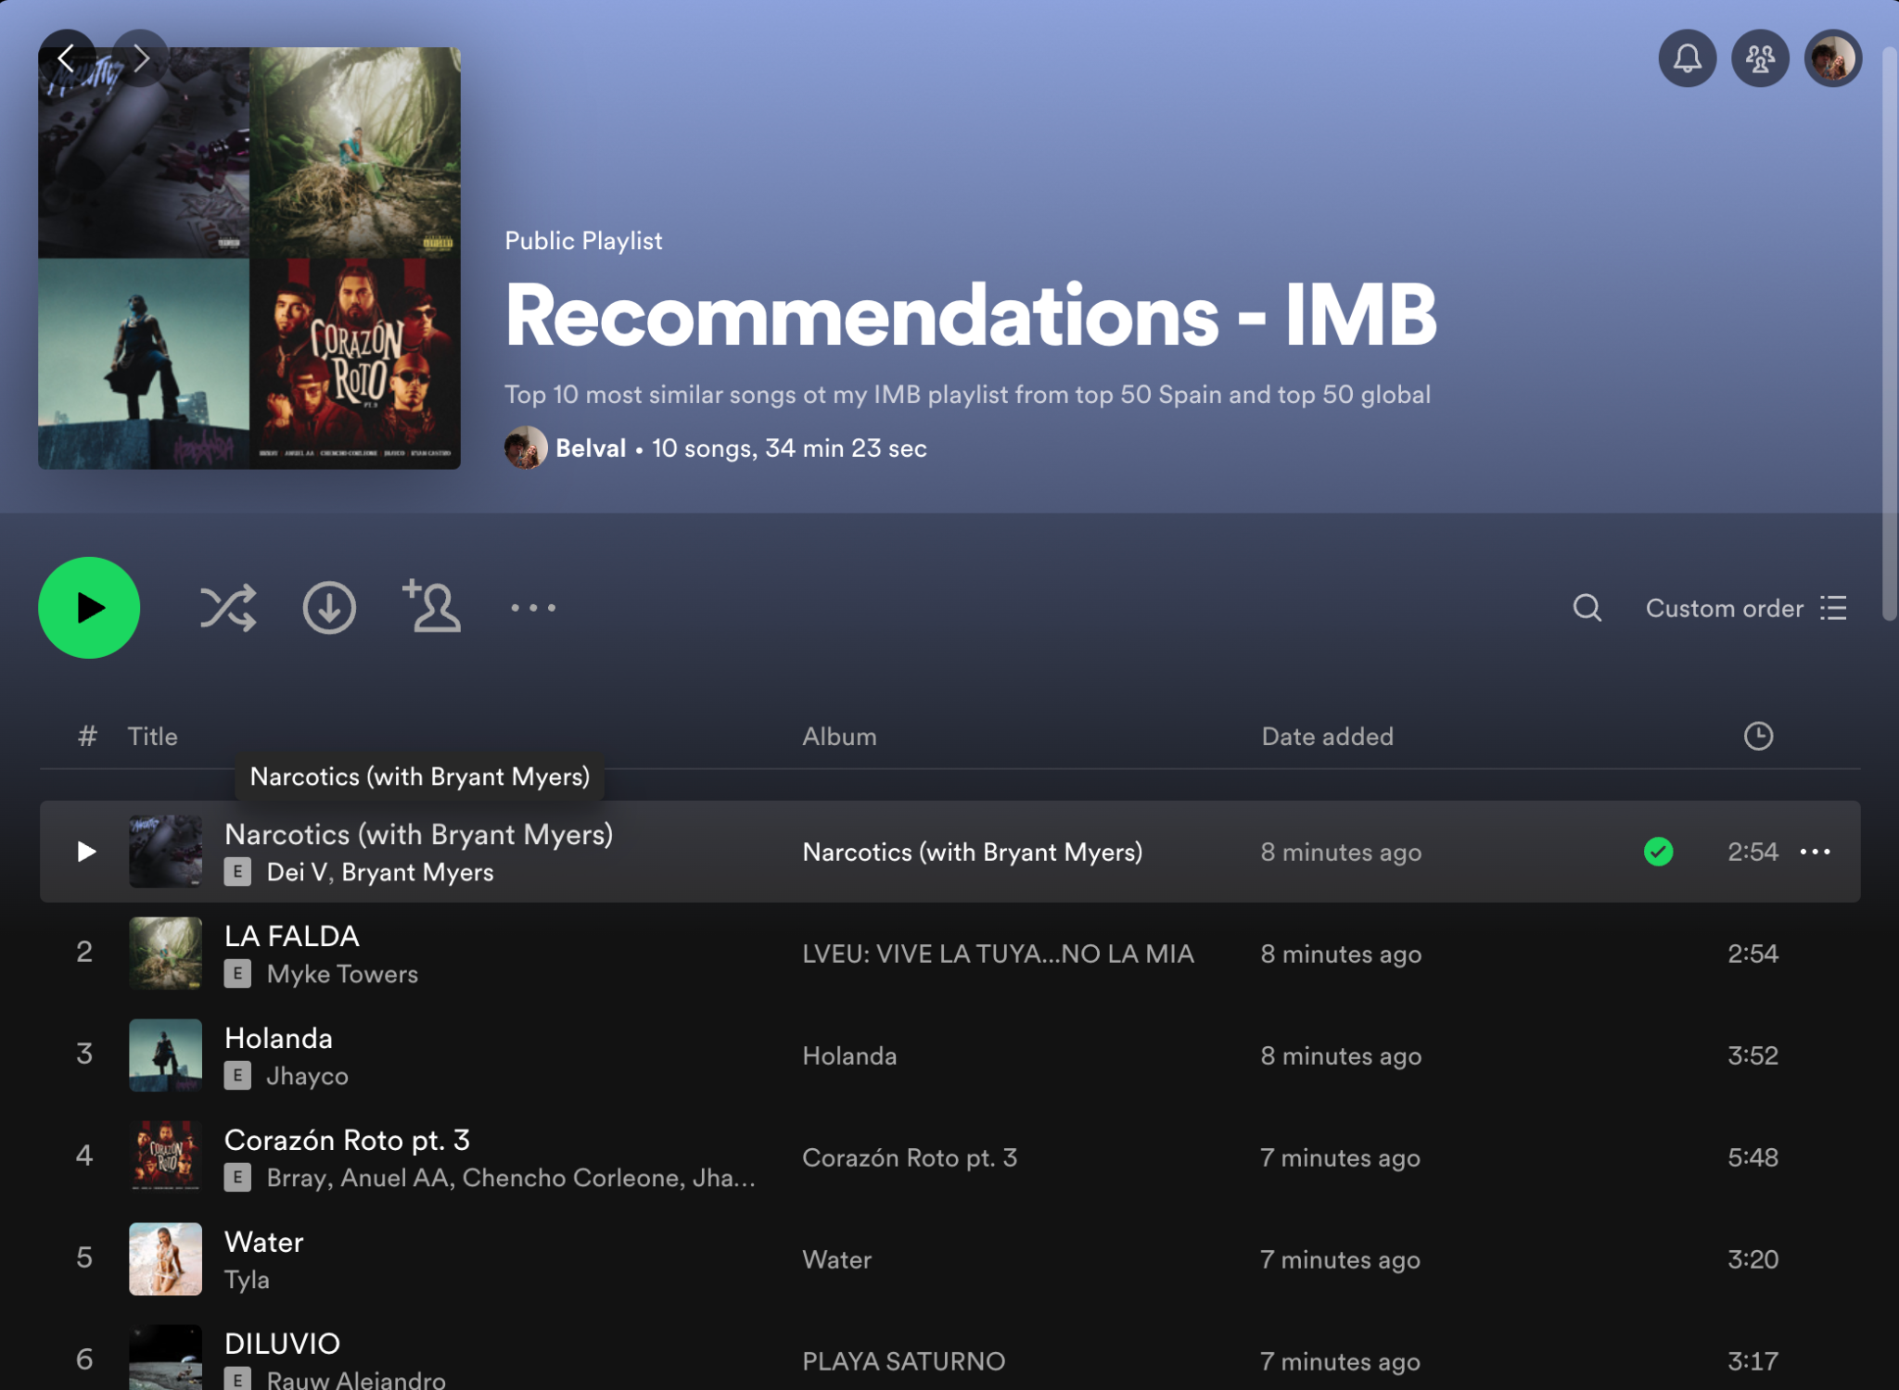
RECOMMENDER ALGORITHM - RECOMMENDATIONS

Slide 18
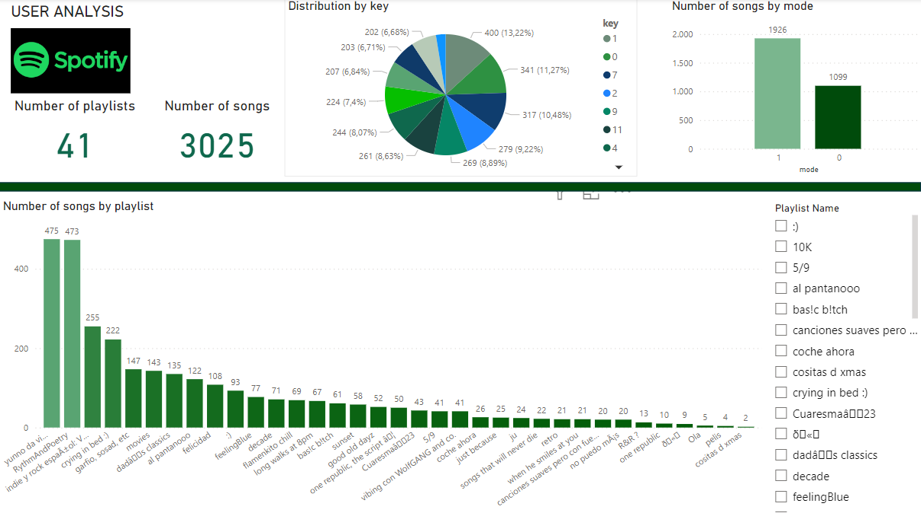
VISUALIZATION – USER ANALYSIS DASHBOARD

Slide 19
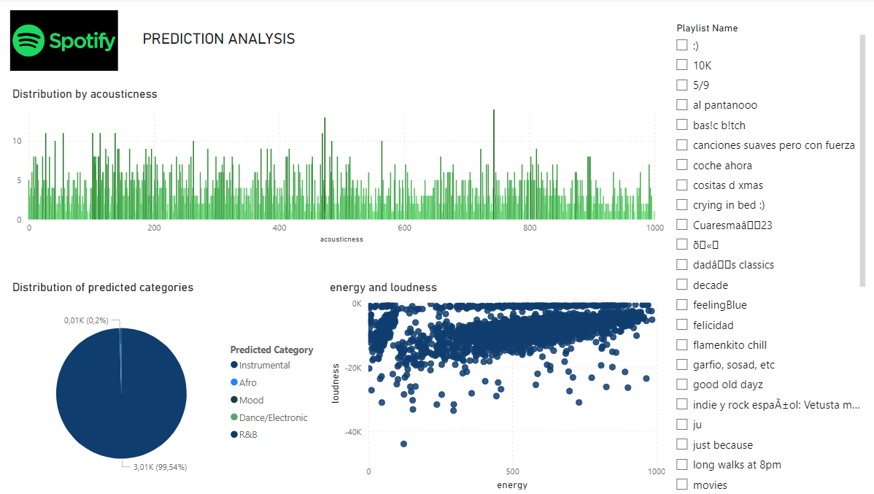
VISUALIZATION – PREDICTION DASHBOARD

Slide 20
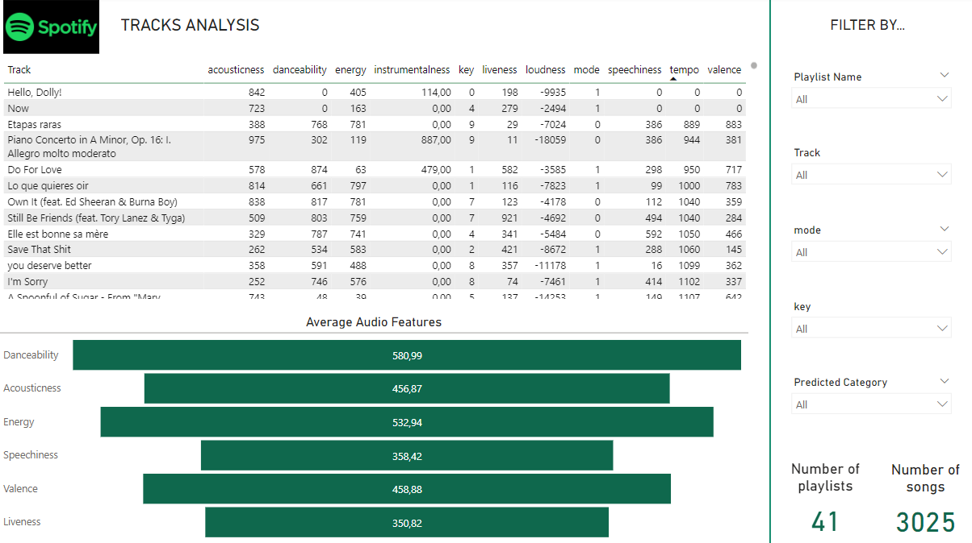
VISUALIZATION – TRACKS ANALYSIS DASHBOARD

Slide 21

CONCLUSION

Slide 22
DISCUSS FUTURE GOAL
Optimize classification techniques
Implement it in Spotify for those who want to analyze their account.
Achieve a larger and more accurate dataset.
Notes:
- Optimizar las tecnicas de clasificación
- Conseguir un dataset más grande y accurate
- Implementarlo en Spotify para quien quiera hacer análisis de su cuenta

